Slide 1

Power BI, Excel and Paginated Reports – better together!
Using a published Power BI Dataset

Slide 2
Sue Bayes
https://www.linkedin.com/in/suebayes/
@sue_bayes
https://databayes.co.uk/
Data Platform MVP

Slide 3
Session Plan
Question
Stakeholders
Stakeholder Requirements
Stakeholder Skill and IT access
Power BI – create model & report
Excel – Analyse in Excel and Connected Table
Paginated Reports – in Service
PowerPoint

Slide 4

Why?

Slide 5




Stakeholder Reporting Needs

Slide 6

Reporting Needs
Coach – are the goals being met? Progress to date? Do they need to worry?
Me – what do I need to do? Am I meeting goals? More details – HR, Speed, ….
Running friends – details?
Family – on track?

Slide 7
Stakeholder IT skills and accessibility
What is their skill level?
What access do they currently have?
What access will they need?
What will they engage with?
Notes:
4.10

Slide 8
Power BI Demo
Pull in data from different sources
Clean and transform the data once – Power Query
Create a data model – star schema
Use Dax to create measures
Visualise results
Notes:
Show file management system –
https://powerbi.microsoft.com/en-us/blog/enabling-granular-access-control-for-all-data-connection-types/

Slide 9
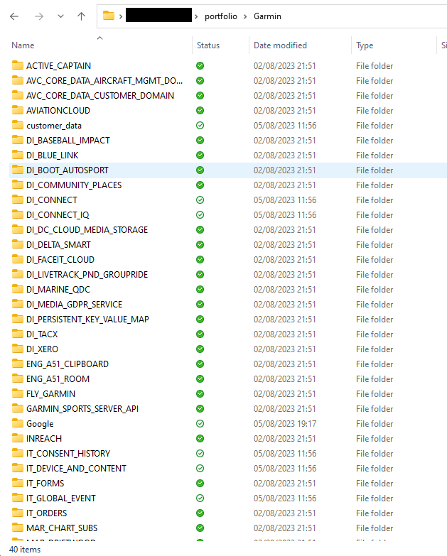
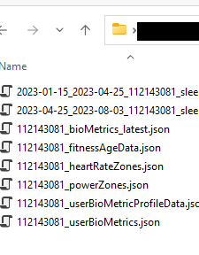
Data extract emailed from Garmin – zipped file that when extracted gives json documents
Marathon spreadsheet – on one drive
Notes:
Transformations – refresh capability
- Date table
Sleep table example
Unix change
Name change
Text alterations
Change from seconds to minutes or work out mileage and change
Do once

Slide 10
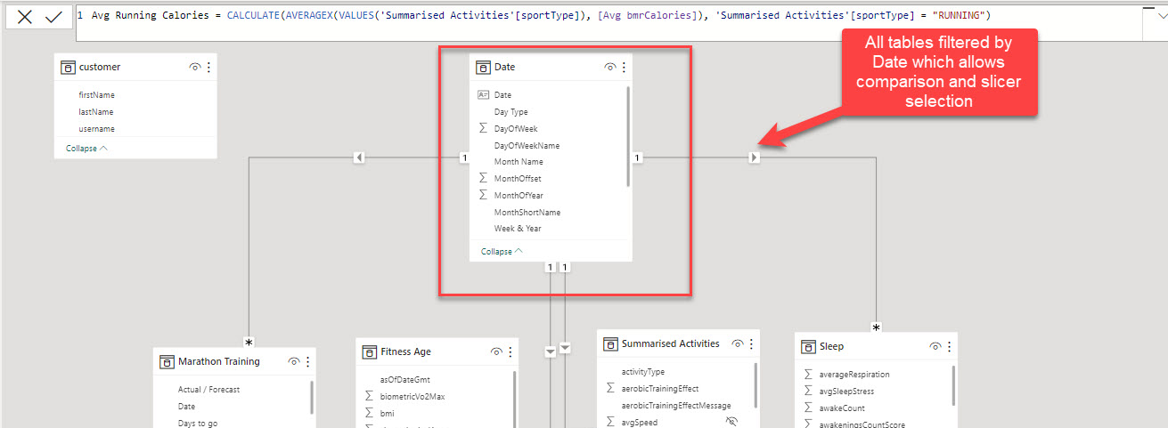
Power BI datamodel
Notes:
4.25

Slide 11
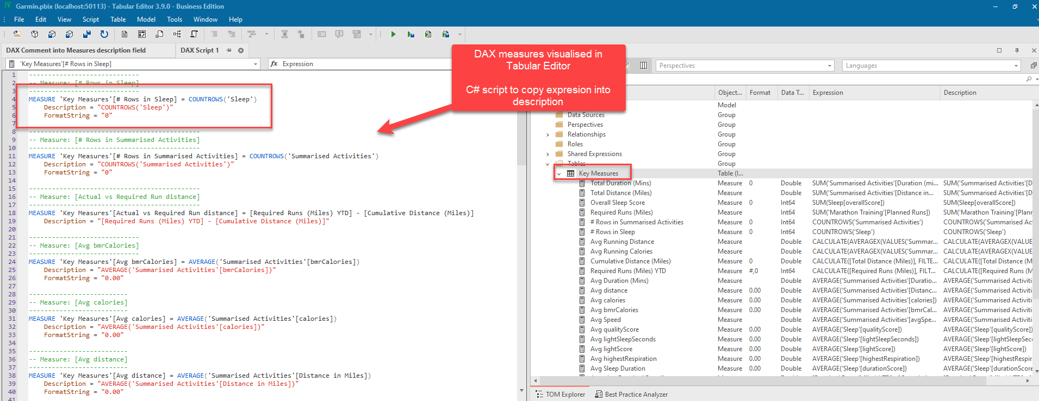
DAX expressions
Notes:
Tabular Editor

Slide 12

Live Power BI Report

Slide 13
Power BI Dataset
Power BI reports
Excel – Analyse in Excel
Excel – tables
Paginated Reports
Power Automate
Python
Notes:
4.35
Power BI to Excel – note web and desktop excel
Build table
Go to desktop and show dax queries
Show amend for changes to name

Slide 14
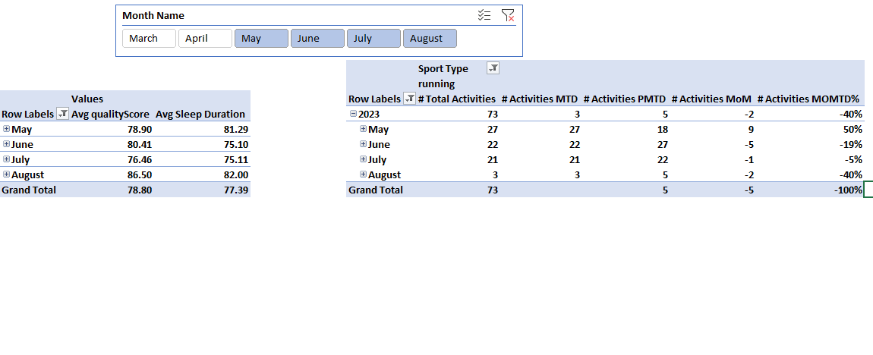
Analyse in Excel
Notes:
4.40

Slide 15
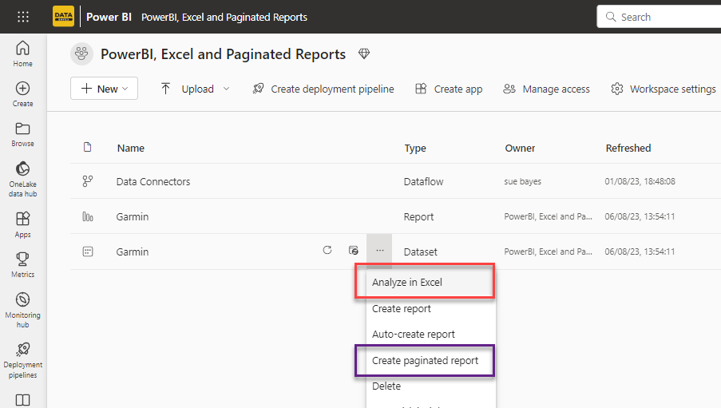
Notes:
https://susan-bayes2.imgbb.com/?page=2&seek=qn6Gqg3
https://imgbb.com/
https://i.ibb.co/FzLfXpL/superior.jpg

Slide 16
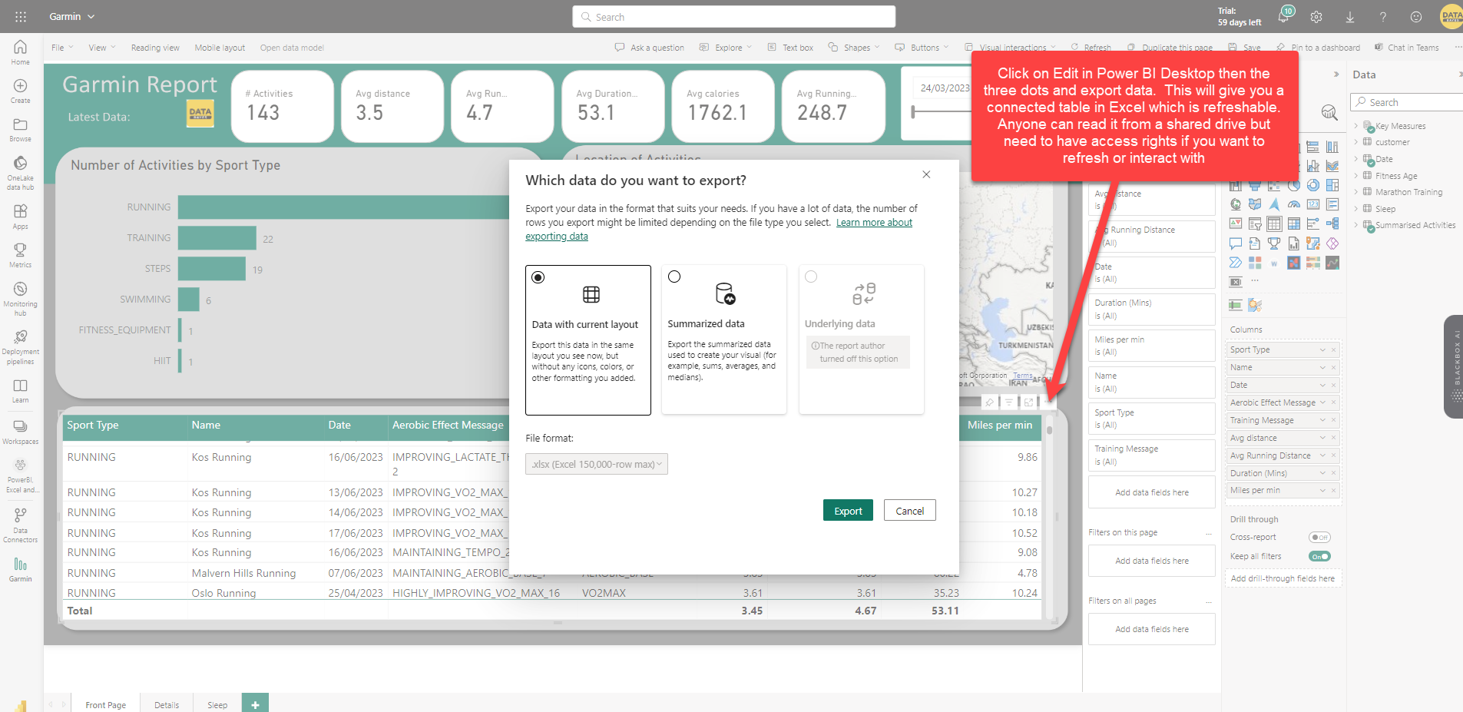
Linked Table
Notes:
4.45

Slide 17
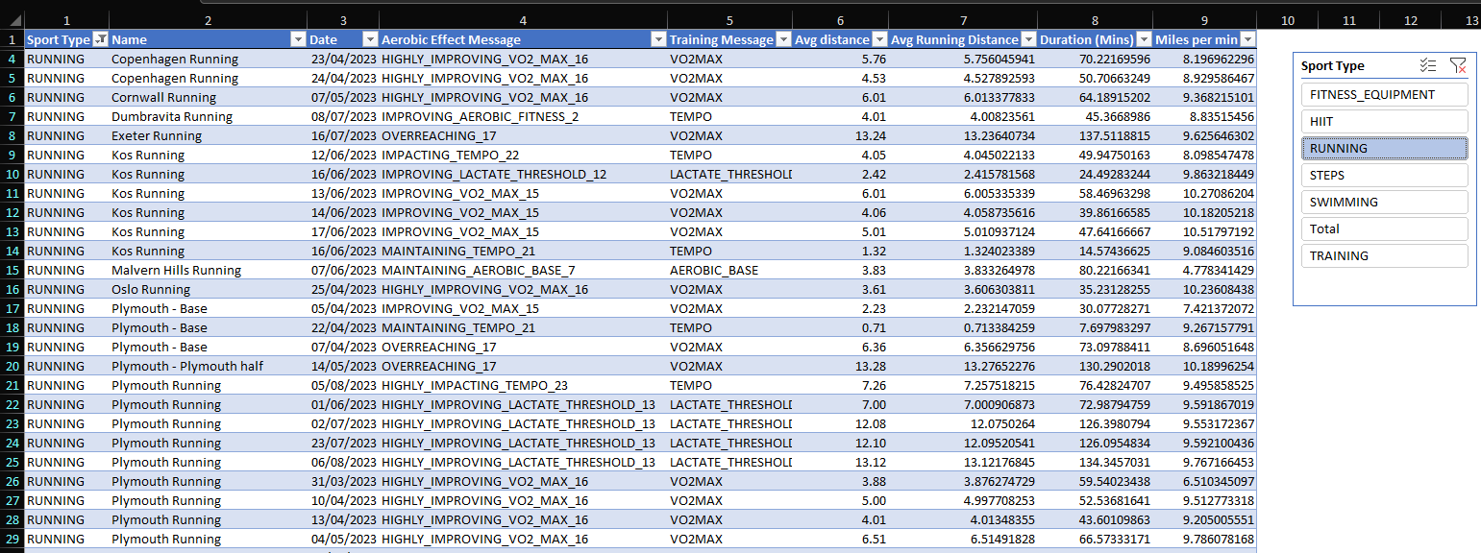
Linked Table

Slide 18

Service
Why?
Printing more than one page
No download limit (1,000,000 as opposed to 150,000)
Legislative
Validation
Non-Power BI Users
Notes:
https://learn.microsoft.com/en-gb/power-bi/collaborate-share/service-power-bi-powerpoint-add-in-install?tabs=share#get-the-url-of-a-visual
https://susan-bayes2.imgbb.com/?page=2&seek=qn6Gqg3
Standard Power BI report visuals impose a 150,000 row limitation when using the Export data option. In contrast, with the paginated report visual, you can export up to 1,000,000 rows to Excel using the Export button in the toolbar, and retain all the formatting in the paginated report
Show options – format, build, print, export, save, filter – 10 mins
Limitations
https://ibb.co/vPL967y

Slide 19
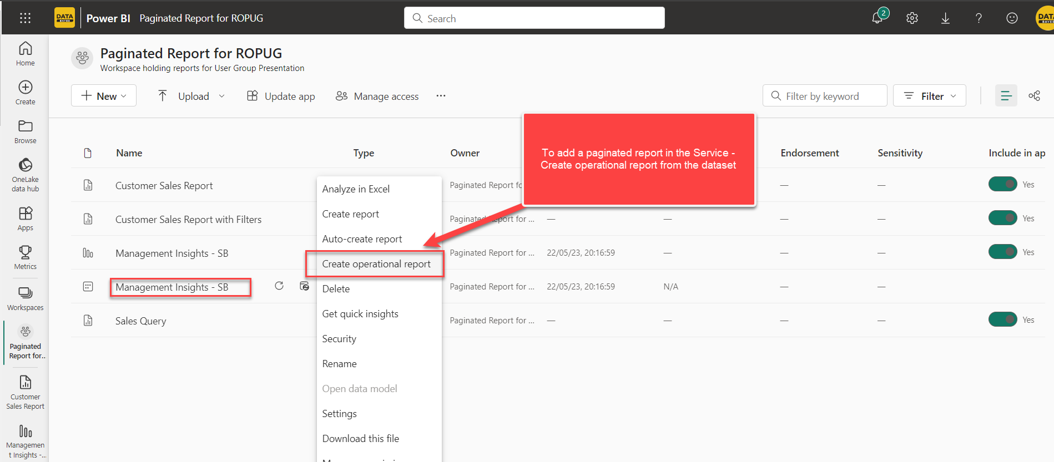
Report in Service
Notes:
Standard Power BI report visuals impose a 150,000 row limitation when using the Export data option. In contrast, with the paginated report visual, you can export up to 1,000,000 rows to Excel using the Export button in the toolbar, and retain all the formatting in the paginated report
Show options – format, build, print, export, save, filter – 10 mins
Limitations
https://ibb.co/vPL967y
= IIF(Me.Value>=12, “Red", “Black")
= IsNothing(Fields!Key_20_Measures_Total_20_Distance_20__28_Miles_29_.Value) = IIF(Me.Value>=20, "16pt", "10pt") = IIF(Me.Value>=20, "Bold", "Default")

Slide 20
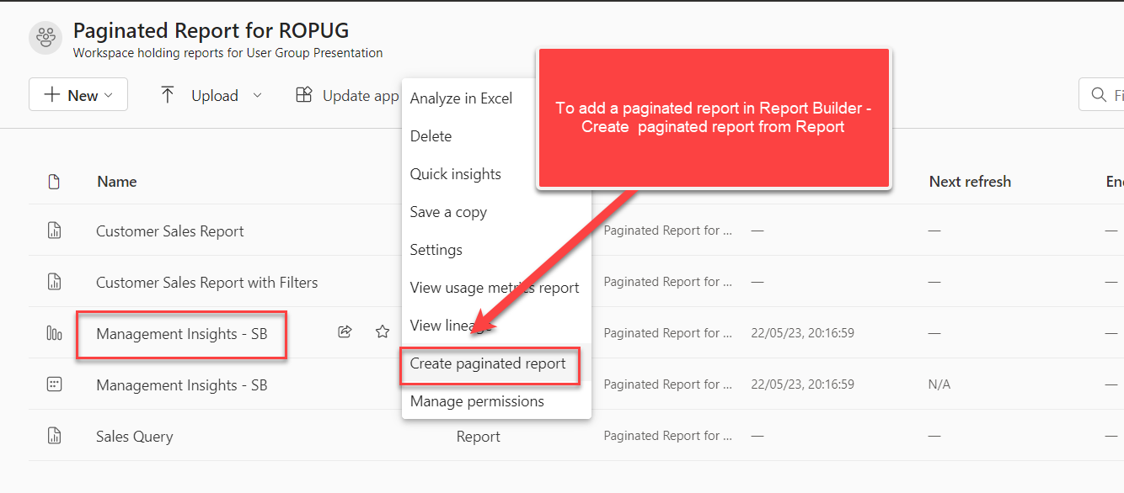
Report in Report Builder

Slide 21
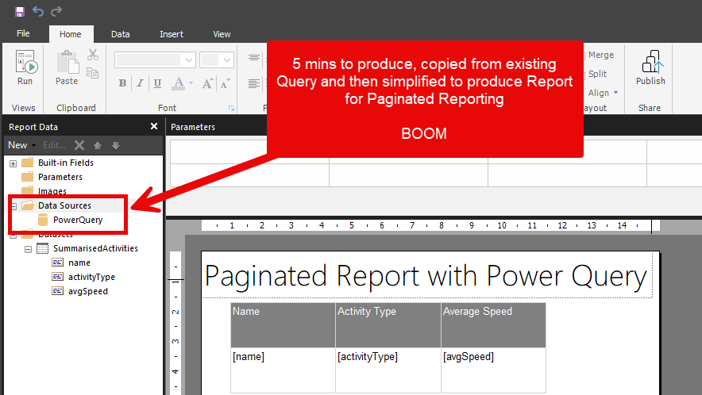

Slide 22
Session Plan
Question
Stakeholders
Stakeholder Requirements
Stakeholder Skill and IT access
Power BI – create model & report
Excel – Analyse in Excel and Connected Table
Paginated Reports – in Service
PowerPoint

